Slide 1
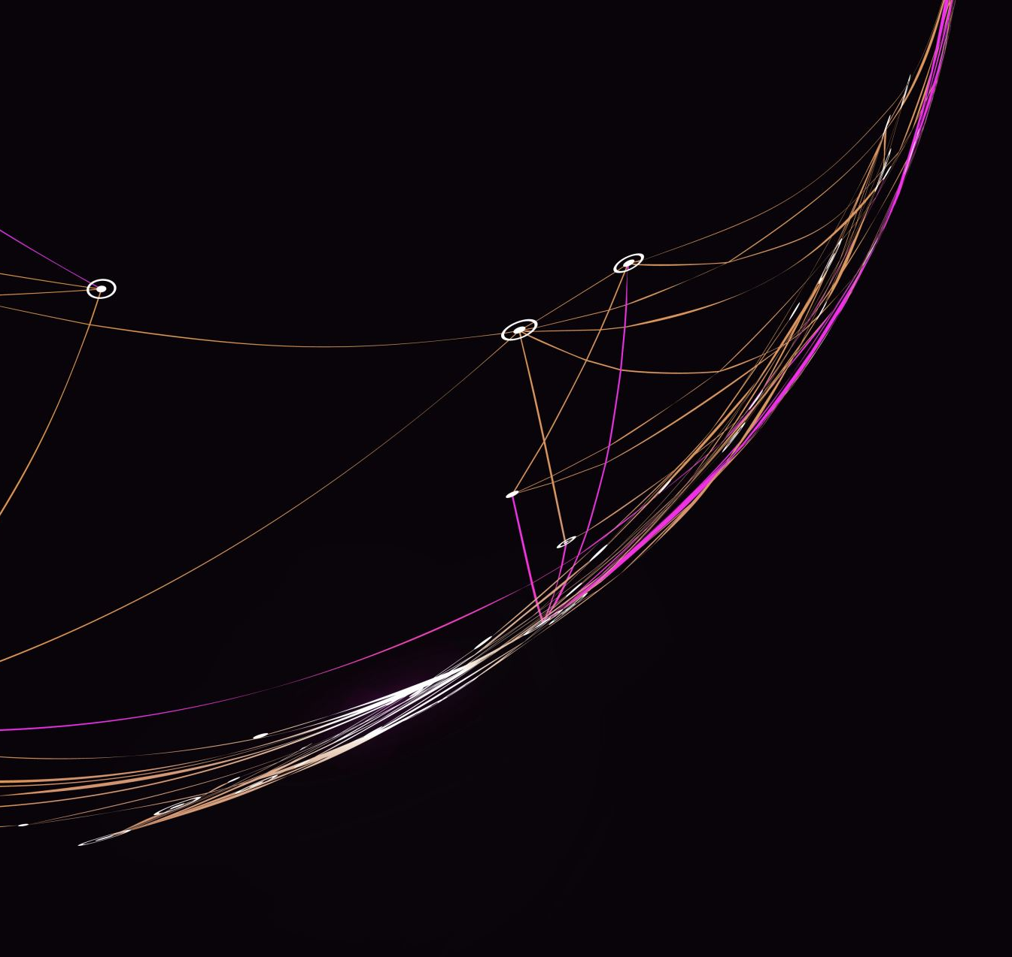
PHISHING AWARENESS TRAINING

Slide 2
Introduction to Phishing
Phishing is a form of social engineering and scam where attackers deceive people into revealing sensitive information or installing malware such as ransomware.
Phishing attacks have become increasingly sophisticated and often transparently mirror the site being targeted, allowing the attacker to observe everything while the victim is navigating the site, and transverse any additional security boundaries with the victim.
As of 2020, it is the most common type of cybercrime, with the FBI's Internet Crime Complaint Center reporting more incidents of phishing than any other type of computer crime.

Slide 3
How does Phishing work?
Anyone who uses the internet or phones can be a target for phishing scammers.
Phishing scams normally try to:
1. Infect your device with malware.
2. Steal your private credentials to get your money or identity.
3. Obtain control of your online accounts.
4. Convince you to willingly send money or valuables.
Sometimes these threats don’t stop with just you. If a hacker gets into your email, contact list, or social media, they can spam people you know with phishing messages seemingly from you.

Slide 4
Phishing prevention has become essential as more criminals turn towards online scams to steal personal information.
We know to dodge spam emails, but phishing emails can look deceivingly credible. Some are even personalized specifically.
Scams are nothing new on the web, but phishing is harder to spot than you might think.
Across the web, phishing attacks have baited unsuspecting victims into handing over bank info, social security numbers, and more. Plus, cybercriminals have become even savvier with their disguises.
Sometimes these scams hide behind voices you know and trust, like your coworkers, your bank, or even your government.
If you so much as click a link, you could be the scammer’s next victim.

Slide 5
Types of Phishing Attacks
Phishing email appears in your email inbox, usually with a request to follow a link, send a payment, reply with private info, or open an attachment. The sender’s email might be tailored to closely resemble a valid one and may contain info that feels personal to you.
Domain spoofing is a popular way an email phisher might mimic valid email addresses. These scams take a real company’s domain (ex: @america.com) and modify it. You might engage with an address like “@arneria.com” and fall victim to the scheme.
Voice phishing (vishing): scammers call you and impersonate a valid person or company to deceive you. They might redirect you from an automated message and mask their phone number. Vishers will try to keep you on the phone and urge you to act.

Slide 6
SMS phishing (smishing) similarly to vishing, this scheme will imitate a valid organization, using urgency in a short text message to fool you. In the message, you’ll usually find a link or a phone number they want you to use. Mobile messaging services are also at risk of this.
Social media phishing involves criminals using posts or direct messages to persuade you into a trap. Some are blatant like free giveaways or sketchy “official” organization pages with an urgent request. Others might impersonate your friends or build a relationship with you long-term before ‘attacking’ to seal the deal.
Clone phishing duplicates a real message that was sent previously, with legitimate attachments and links replaced with malicious ones. This appears in email but may also show up in other means like fake social media accounts and text messages.

Slide 7
Common Signs of Phishing
Misspelled or suspicious sender email addresses.
Urgent or threatening language.
Requests for sensitive information.
Suspicious attachments or links.
Notice from bank.
Email from a “friend”.
Contest winner/Inheritance email.
Tax refund/rebate.

Slide 8
Examples of Phishing Scenarios
Iran Cyberattack phishing scams use an illegitimate Microsoft email, prompting a login to restore your data in attempts to steal your Microsoft credentials. Scammers use your fear of being locked out of Windows and the relevance of a current news story to make it believable.
Notice from bank. This scam tricks you with a fake account notification. These emails normally give you a convenient link which leads to a web form, asking for your bank details “for verification purposes.” Do not give them your details. Instead, give your bank a call as they may want to act on the malicious email.
Email from a ‘friend’. This scam takes the form of a known friend who is in a foreign country and needs your help. This ‘help’ normally involves sending money to them. So, before you send your ‘friend’ money, give them a call first to verify whether it’s true or not.

Slide 9
Contest winner/Inheritance email: If you’ve won something unexpectedly or received an inheritance from a relative you've never heard of — don’t get too excited. Because most of the time these emails are scams that require you click on a link to enter your info for prize shipment or inheritance ‘verification’.
The tax refund/rebate: This is a popular phishing scam as many people have annual taxes which they pay or must submit payment to. These phishing messages normally say that you are either eligible to receive a tax refund, or you have been selected to be audited. It then requests that you submit a tax refund request or tax form (asking for your full details), which scammers then use to either steal your money and/or sell your data on.

Slide 10
Best Practices for Avoiding Phishing Attacks
Verify sender identities.
Hover over links to check their destination URLs.
Avoid providing personal or financial information in response to unsolicited requests.
Enable multi-factor authentication whenever possible.
Check the link, before you click — make sure the links start with https:// and not http://
Do not rush or panic react — scammers use this in order to pressure you into clicking links or opening attachments.
Report all scams.

Slide 11
Training Exercises
Generally, the following features are common among phishing emails and should raise red flags:
Attachments or links
Spelling errors
Poor grammar
Unprofessional graphics
Unnecessary urgency about verifying your email address or other personal information immediately
Generic greetings like "Dear Customer" instead of your name.
Hackers often rush to get phishing sites up, so some of them will look significantly different from the original company. You can use these traits to pick a malicious email out of your inbox.

Slide 12
Reporting Phishing Attempts
Encourage participants to report suspicious emails or websites to their organization's IT/security team.
Provide guidance on how to report phishing incidents effectively.

Slide 13
Conclusion
Phishing can be a difficult area to tackle at times, by following the simple tips and advice outlined in this article (and embracing proper phishing prevention tools) — you can greatly minimize your risk of falling victim to digital scammers.
For more information visit : https://www.kaspersky.com/resource-center/preemptive-safety/phishing-prevention-tips, https://en.wikipedia.org/wiki/Phishing

